Slide 1
Research Presentation
Game data analytic using descriptive and predictive mining
By:- Priti Maurya

Slide 2
QQ -Plots
Create QQ plots
The R base functions qqnorm() and qqplot() can be used to produce quantile-quantile plots:
qqnorm(): produces a normal QQ plot of the variable

Slide 3
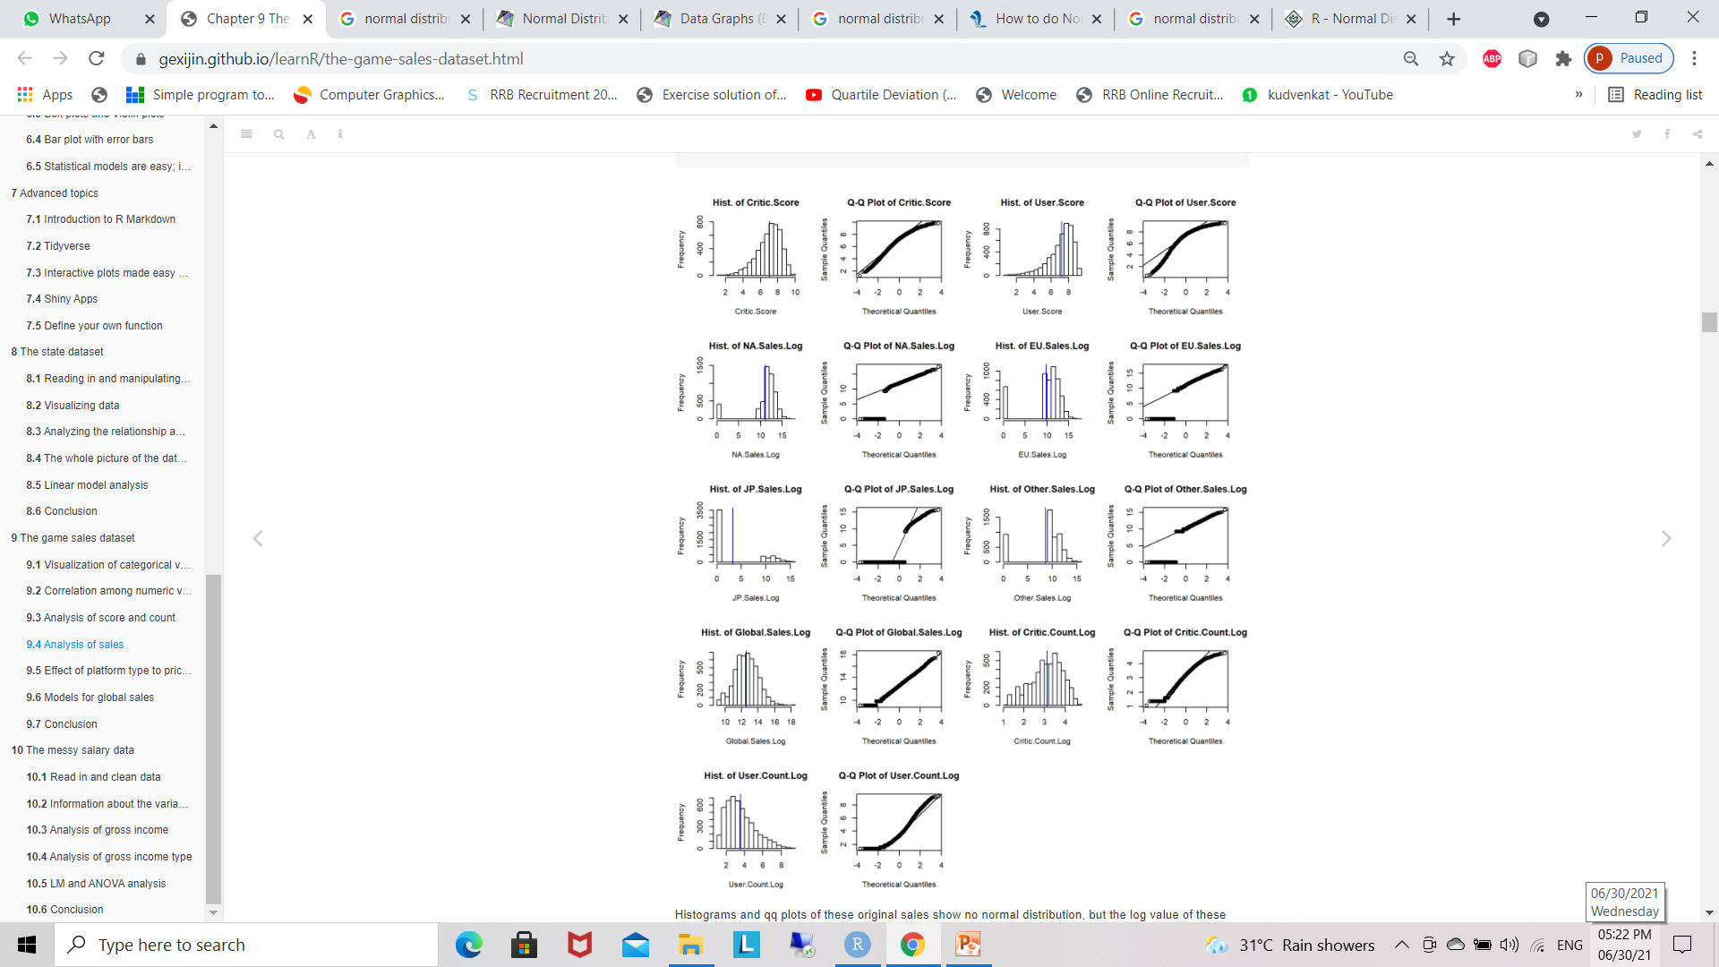
QuantileQuantile-Plot

Slide 4
Histograms and qq plots of these original sales show no normal distribution, but the log value of these sales are much close to normally distributed, especially the log value of global sales.
Though the Shapiro test with p value lass than 0.05 deny its normality, it’s much better than the other sales or other log values of sales. Maybe the missing value of sale is the reason of abnormality.
From the histograms and qq plots we also see that two scores and log values of their counts are close to normal distribution.

Slide 5
Algorithms:
Normal Distribution and histogram and qq plot :
Step 1: start add data
Step 2: Clean data
Step 3: actual data multiply by 1000000.
Step 4: Adding +1 to make sales data positive.
(This is for Log value)
Step 5: Critical Score /10(Making data vale in decimal)
Step 6: Log value transformation in variable
Step 7: Combine Log variable with Original Variable
Step 8: plot histogram and QQ plot:
Step 9: Take two columns of shapiro.test
Step 10 : add variable mean

Slide 6
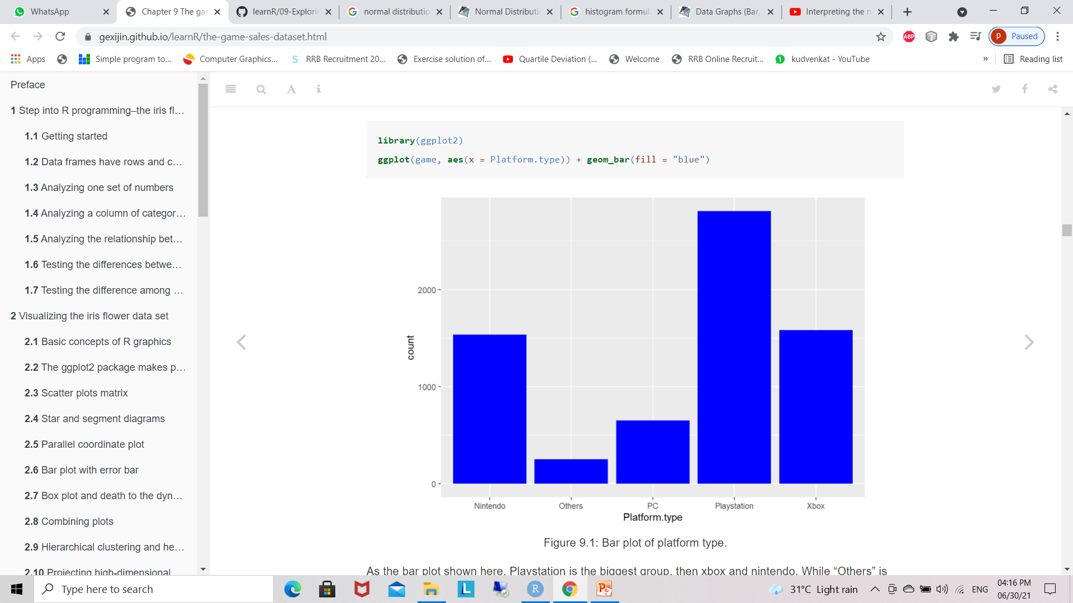
Visualization of categorical variables
Regroup platform as Platform.type
Bar graph
regroup Rating as Rating.type
rename the names of counts for detail information
According to the order, the most popular ratings are T, E, M and E10+. “Others” rating only occupy very little portion in the all games.

Slide 7
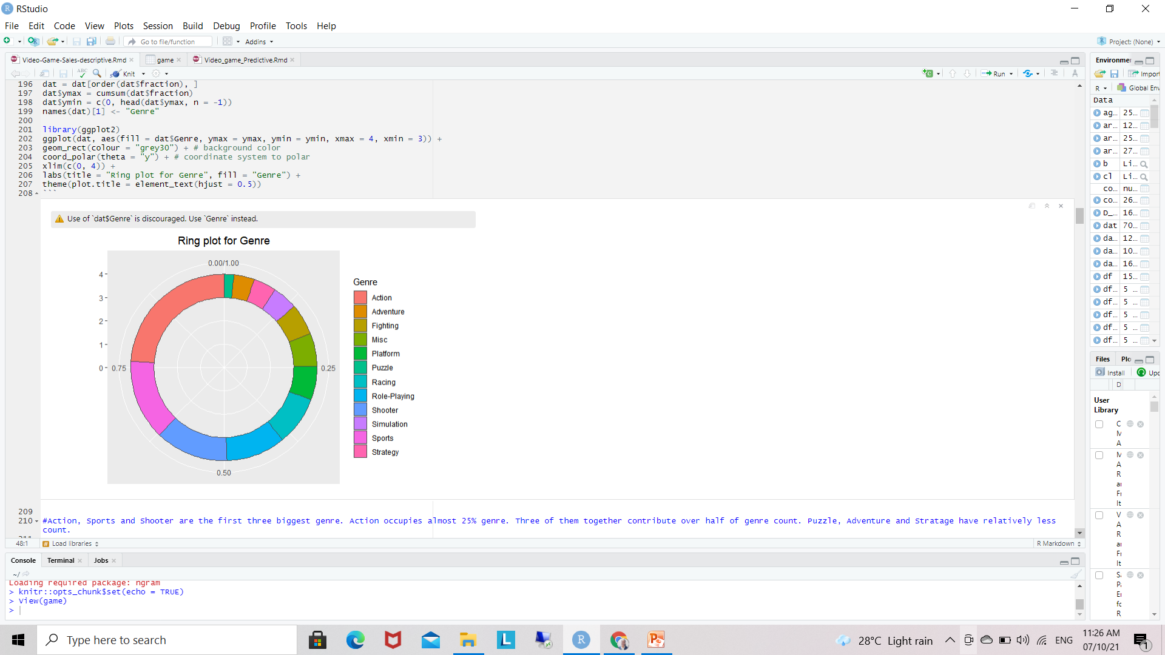
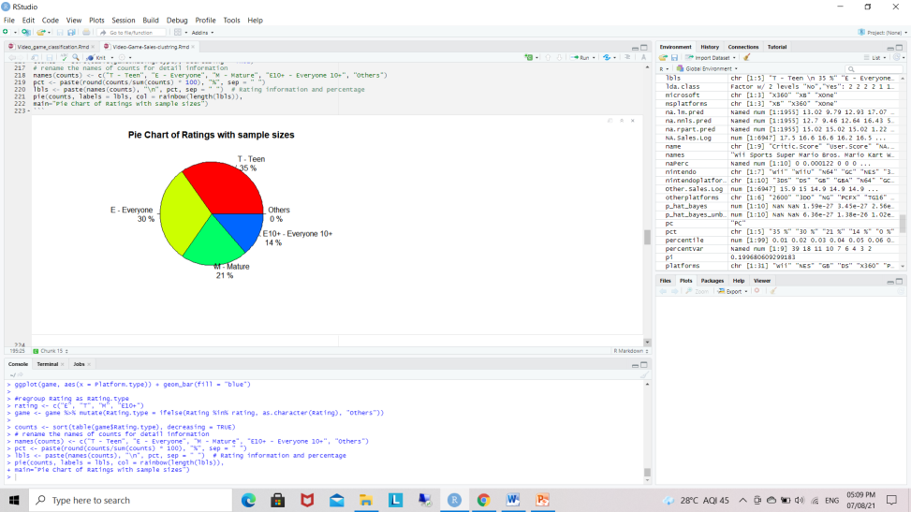
Ring plot and Pie chart
Ring Plot
Pie chart

Slide 8
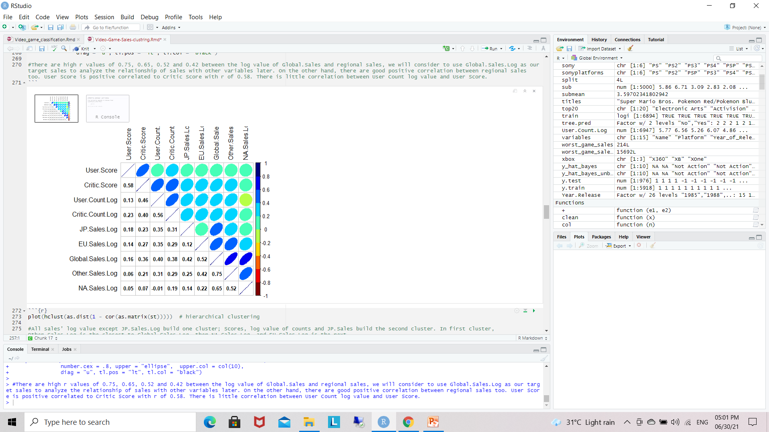
Correlation among numeric variables
Take numeric variables as goal matrix
Correlation matrix
There are high r values of 0.75, 0.65, 0.52 and 0.42 between the log value of Global.Sales and regional sales.
On the other hand, there are good positive correlation between regional sales too. User Score is positive correlated to Critic Score with r of 0.58. There is little correlation between User Count log value and User Score.

Slide 9
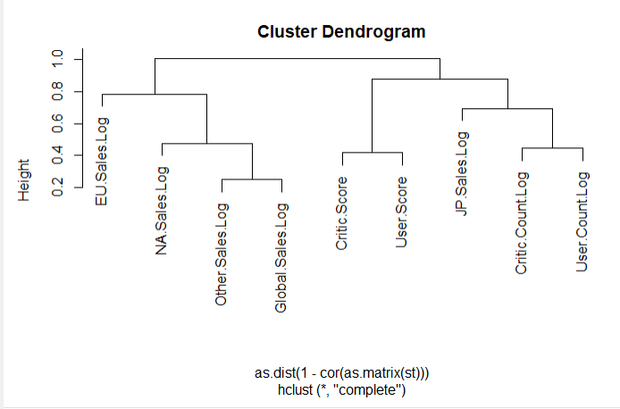
Cluster dendrogram for numeric variables.
plot(hclust(as.dist(1 - cor(as.matrix(st)))))
hierarchical clustering
All sales’ log value except JP.Sales.Log build one cluster; Scores, log value of counts and JP.Sales build the second cluster. In first cluster, Other.Sales.Log is the closest to Global.Sales.Log, then NA.Sales.Log, and EU.Sales.Log is the next

Slide 10
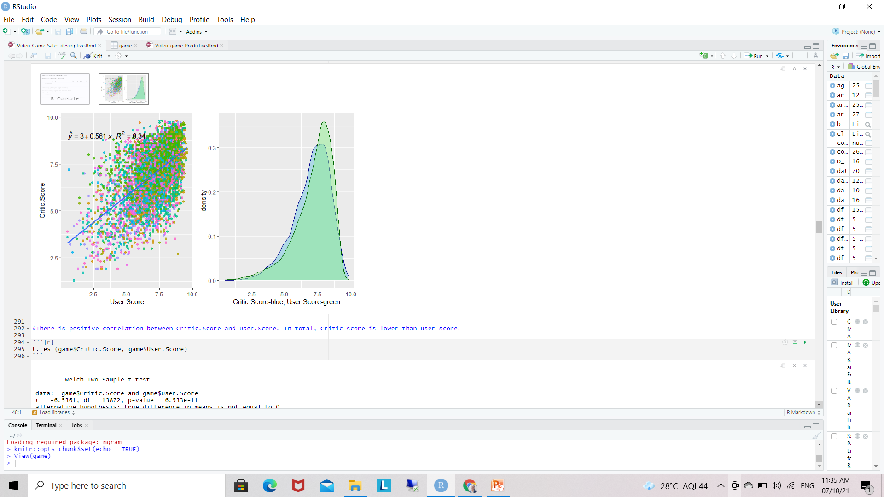
Analysis of score and count
Linear Regration
formula <- y ~ x
add regression line
add regression equation and R square value
output.type as "expression“

Slide 11
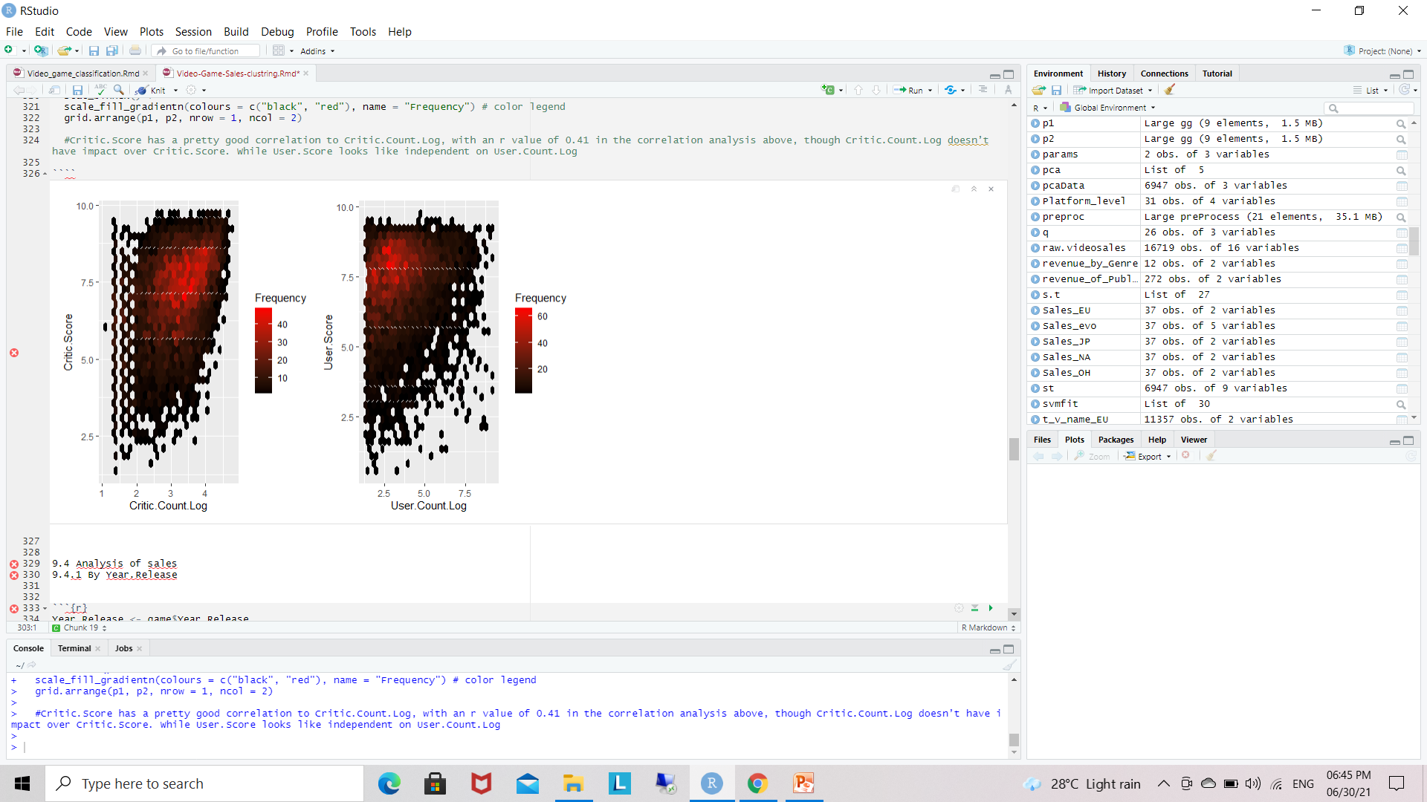
Correlation Analysis
Critic.Score has a pretty good correlation to Critic.Count.Log, with an r value of 0.41 in the correlation analysis above, though Critic.Count.Log doesn’t have impact over Critic.Score. While User.Score looks like independent on User.Count.Log

Slide 12
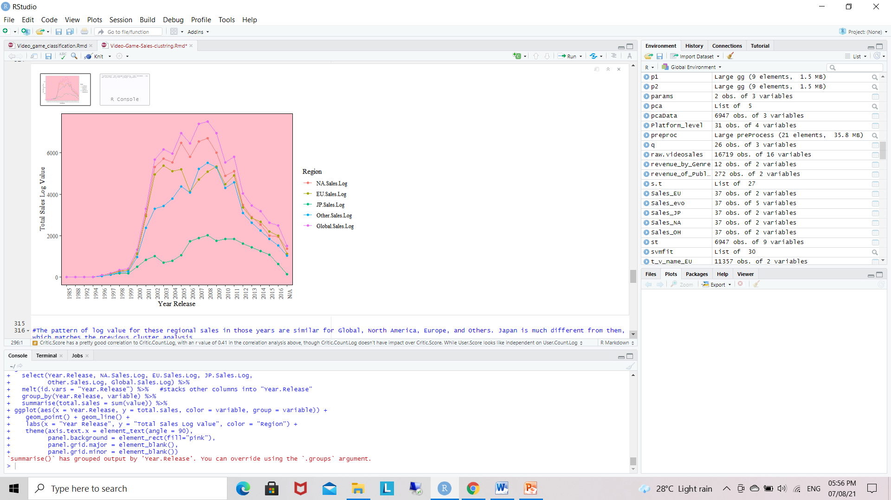
Analysis of sales - By Year.Release
The pattern of log value for these regional sales in those years are similar for Global, North America, Europe, and Others. Japan is much different from them.

Slide 13
Anova
determine whether there are any statistically significant differences between the means of two or more independent (unrelated) groups
compute 1-way ANOVA test for log value of global sales by Platform Type

Slide 14
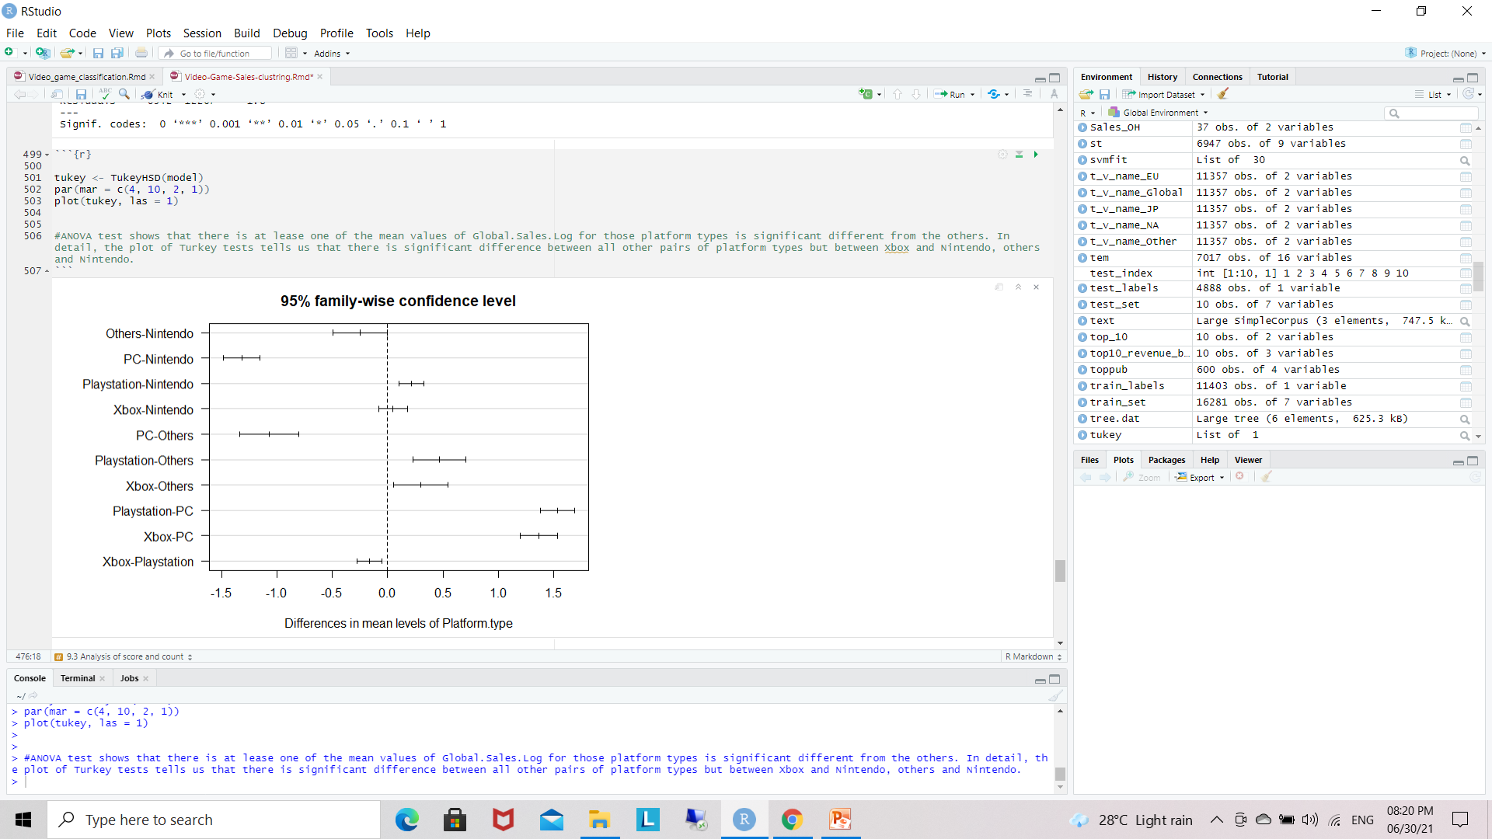
ANOVA test shows that there is at lease one of the mean values of Global.Sales.Log for those platform types is significant different from the others. In detail, the plot of Turkey tests tells us that there is significant difference between all other pairs of platform types but between Xbox and Nintendo, others and Nintendo.

Slide 15
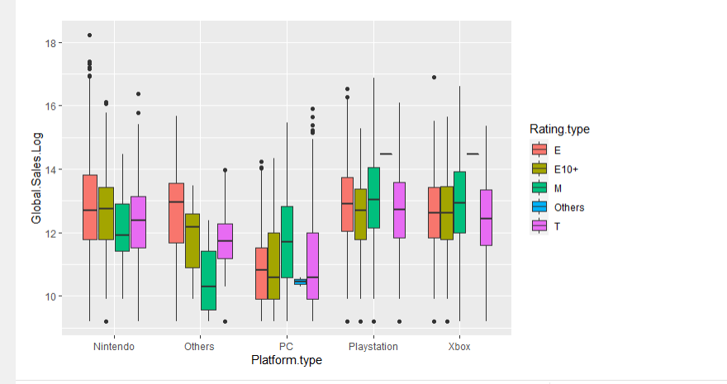
In total, PC has lower Global sales log comparing with other platform type, while Playstation and Xbox have higher sale mediums for different rating types.

Slide 16
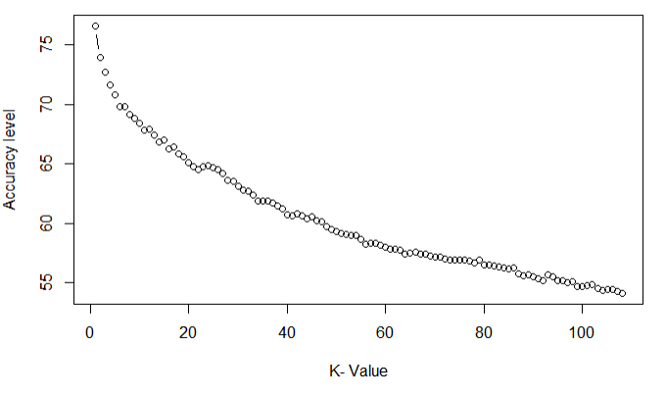
Predictive
KNN-Model
The below graph shows that for ‘K’ value of 1 got the maximum accuracy at 76.636.
This accuracy for NA_SALES
In the kNN Model, we observed that training set produced starting points for the experiment with K = 106 and K = 107. They yielded 54.50082 and 54.41899 respectively. These values were average and did not perform as well as we had hope. We believe that data points being further apart contributed to the outcome. K = 1 produced the most accurate result as we saw in the plot prior, which also aligned correctly with the fact that the game ranking 1st was also that one that had the highest sales. This method can be further tuned.

Slide 17
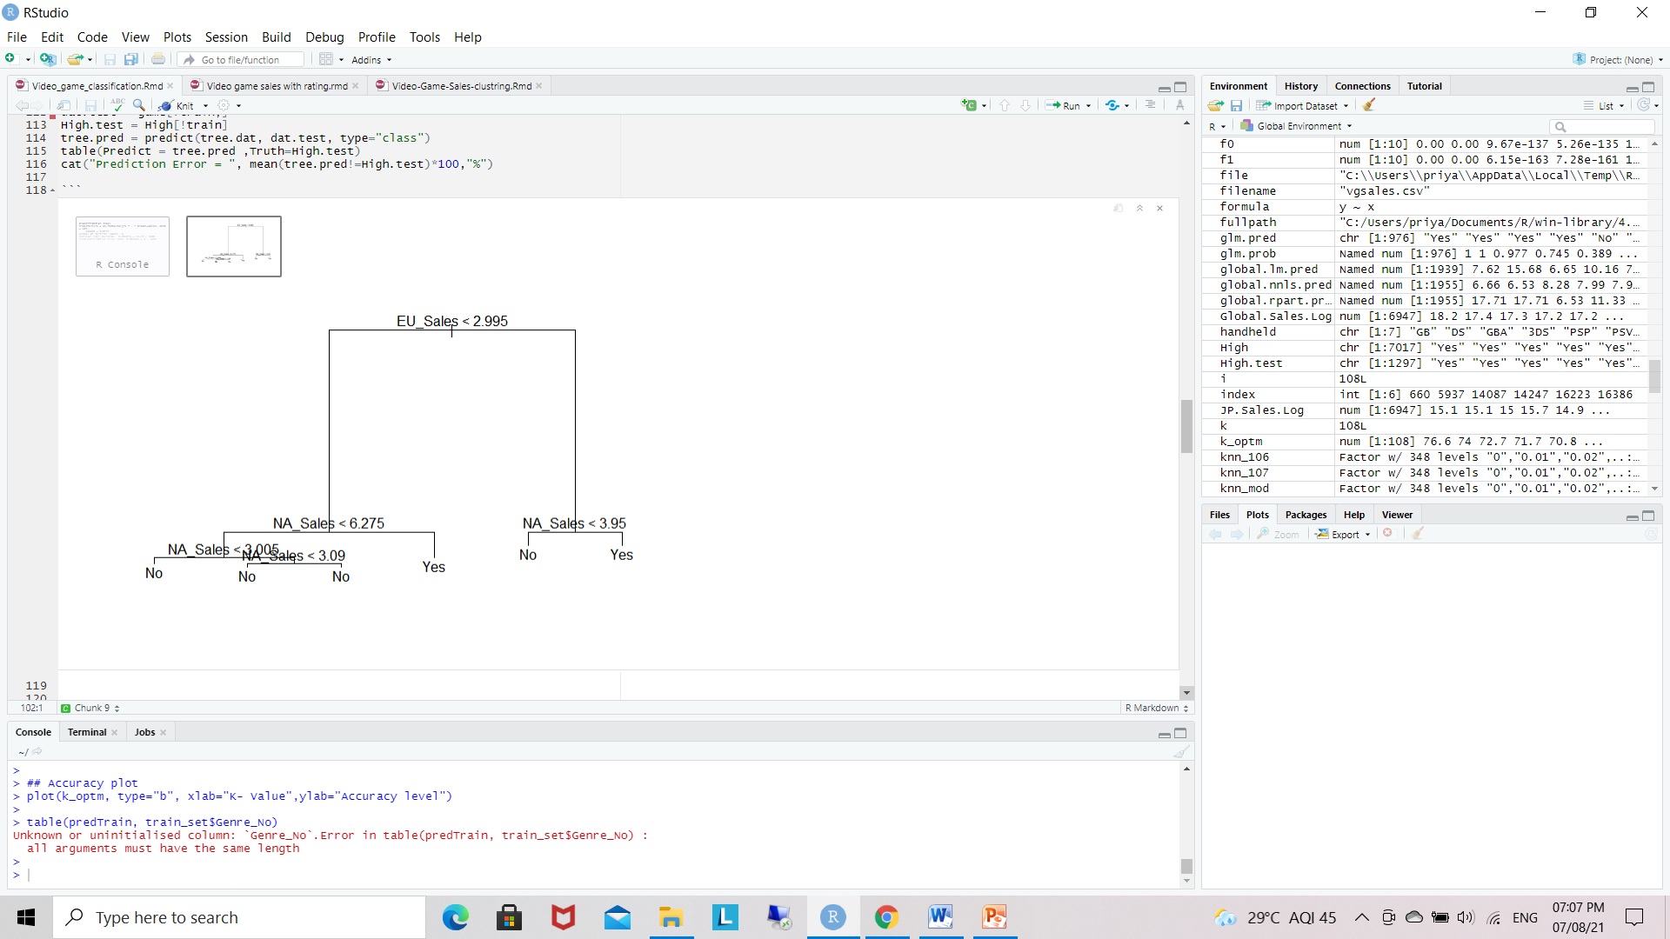
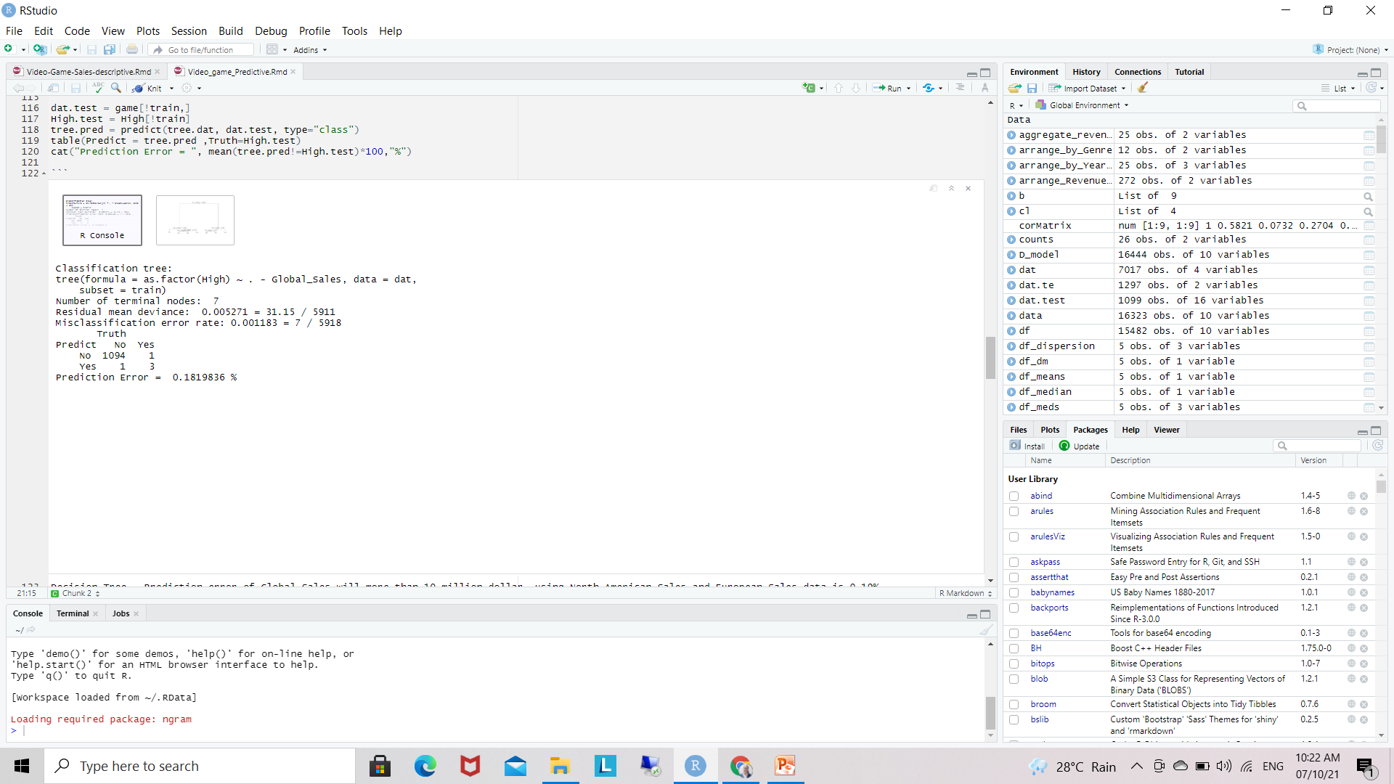
Prediction through Decision Trees
Decision Tree - Prediction error of Global Sales will more than 10 million dollar, using North American Sales and European Sales data is 0.18%.

